Slide 1
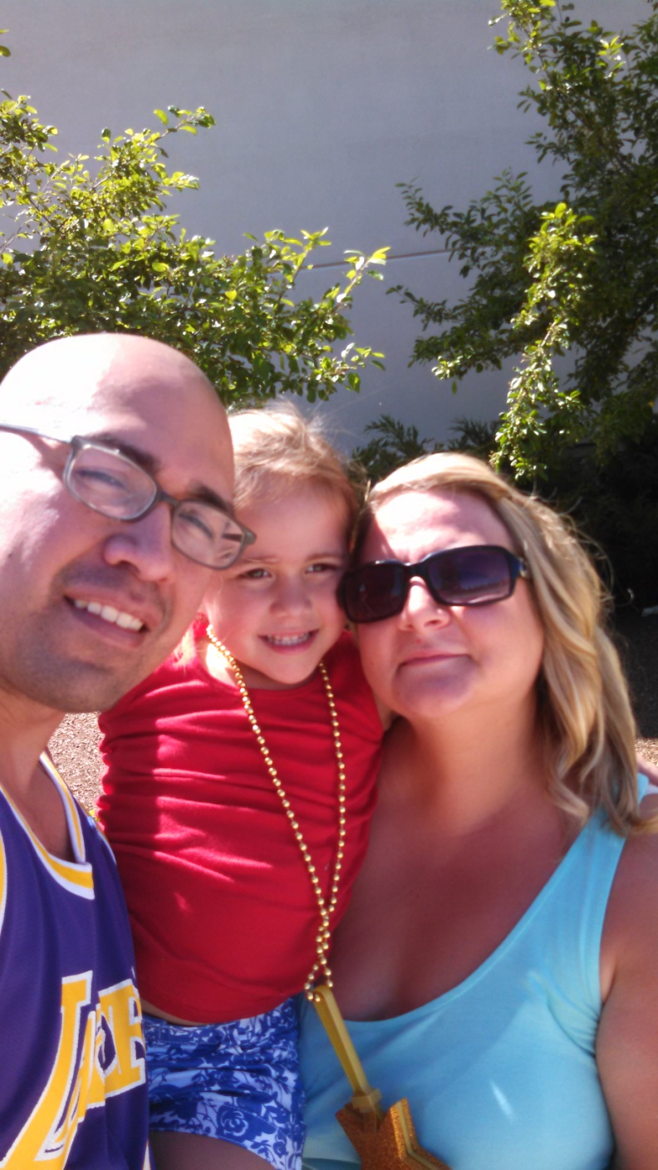
Lindsey Campos
Over the last 12 months, Dil and I have felt God’s hand leading me towards expanding God’s kingdom
As I child, I was raised in Maumee, Ohio. In 2001, I moved to San Diego where I met my husband Dil. We married in 2004.
I studied both at Bowling Green State University and the Art Institute of California
In 2008, we felt the Lord calling us back to Maumee, Ohio
In 2010, the Lord blessed us with our daughter Topanga

Slide 2
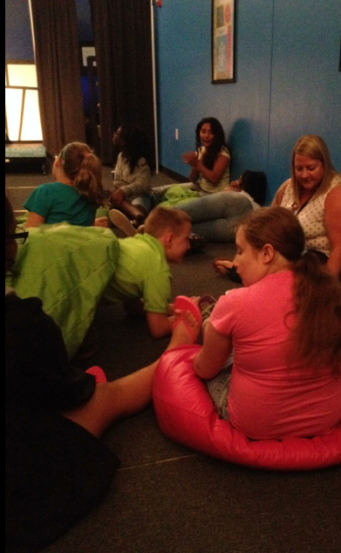
Ministry Experience
Teach curriculum during weekend services
Facilitate youth groups in Fusion & Vertical ministry
Counsel youth with various life challenges
Camp counselor & community leader
Lead Bible studies
Write for Living It Out

Slide 3
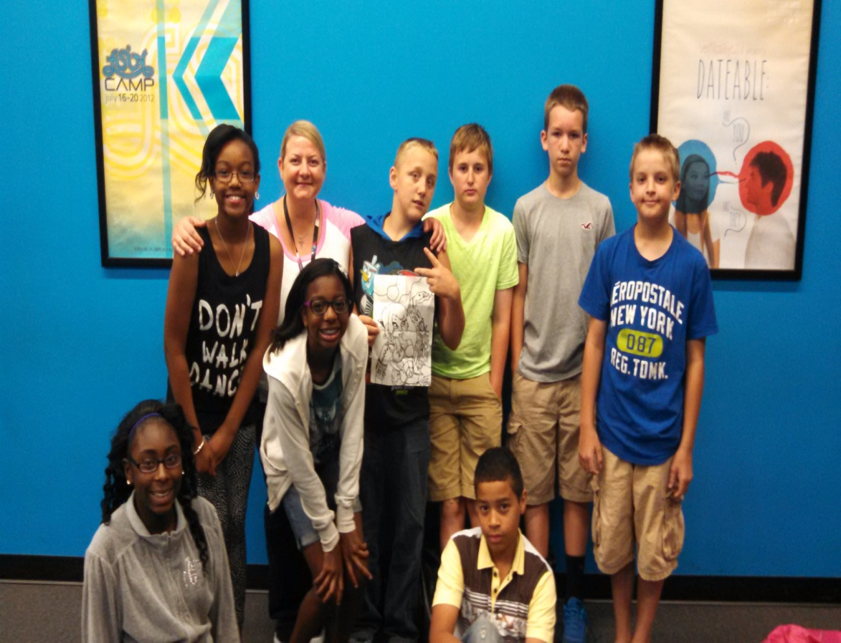
Fusion
Safe place where students come to connect with God, leaders and other students
Learn “Big Points” every week that they can apply to their own lives
Forum to ask questions or express concerns about things they may be experiencing
Every meeting is a chance to impact students lives
Opportunity to reinforce Cedar Creek’s mission of loving Christ, serving others, and telling the world about Him

Slide 4
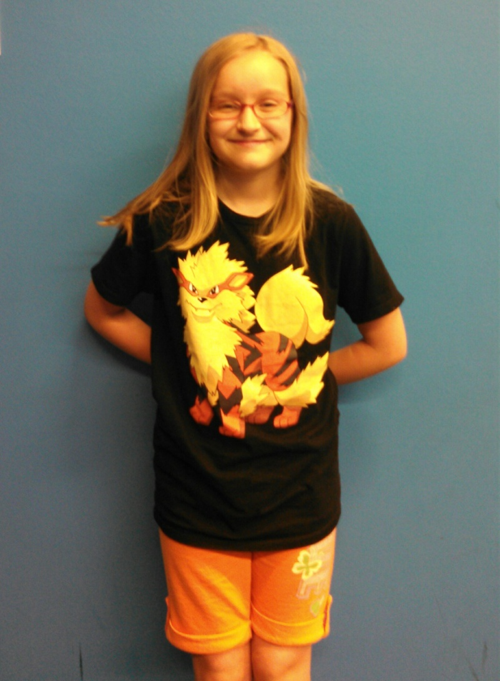
Kayla’s Impact Testimony
Fusion is a place where I am learning about God and His love for us all. I feel I can be myself and just be accepted. I have had a lot of problems with bullying at my school and after talking to Lindsey I feel much more confident in who I am and how I will deal with this problem. She is my favorite leader and I am really glad my mom got to meet her.

Slide 5
Internship Program
Just what will I be doing ?
I will be:
Actively involved at Cedar Creek for thirty to forty hours a week
In active part in Fusion and Vertical
Working with other student ministries leaders/pastors to continue to learn and grow as a leader
Attending all five weekend services
Participating in all retreats, camps, life groups
Assisting in writing any required curriculum for Fusion and Vertical
Occasionally traveling to seminars to sharpen my leadership skills

Slide 6
Benefits of Internship
Introduce me in the intricate workings of a church
Develop deeper relationships with students and other leaders
Grow with other interns while we learn from each other
Enhance my current skill set while growing skills yet to be discovered
Expand leadership capabilities
Discover and experience full-time ministry

Slide 7
Building a Support Team
As iron sharpens iron, so a friend sharpens a friend.
Proverbs 27:17
There must be a support group surrounding me
Your support, in any manner, is crucial
Only with your support will we have an immediate and eternal difference in the lives of students
You are an irreplaceable role in my journey of impacting lives and building God’s Kingdom

Slide 8
Support…What Is Needed
PRAYER for wisdom, direction and discernment
ENCOURAGEMENT in the way of cards, phone calls, visits, emails, etc.
FINANCIAL SUPPORT to allow me to work full time for the church, focusing all my time in the ministry
  My financial goal: $10,000-$12,000 from September 2014-August 2015
  Financial support can be either a one time gift or monthly support

Slide 9
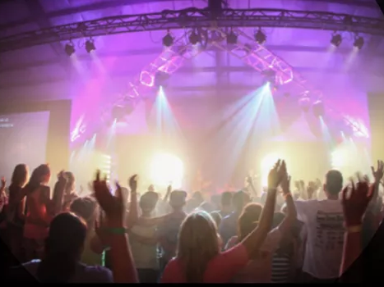
What About You…
Will you join my team?
In what ways can I count on you?
and…

Slide 10

Do you know of anyone who loves God and is positive to the ministry at Cedar Creek who might join my team?

